Slide 1


HOTEL DATABASE MANAGEMENT SYSTEM Prepared By – Aditya Ranajn, Ankit Kumar, Anshika Tyagi, and Bipul Kumar

Slide 2
Table of contents
Introduction
ERR Diagram
Tables & Relationships
Normalization
Queries, Views, Triggers
Challenges
In a nutshell, this shows what we are going to cover today in our presentation of “Hotel Database Management System”.

Slide 3

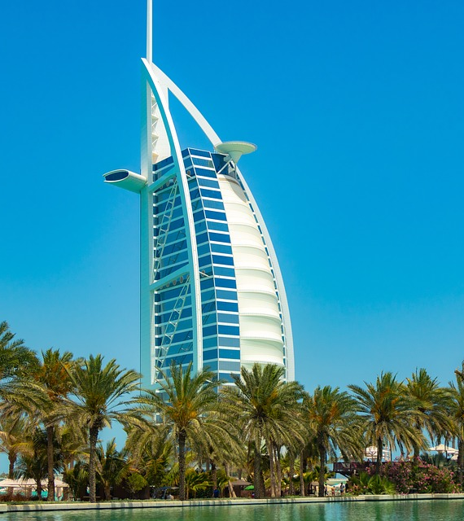
The main objective of this project is to create a database management system for a hotel.
We have built this project as a group of four. The group members are:
Aditya Ranjan
Ankit Kumar
Anshika Tyagi
Bipul Kumar
It was fun working together, overcoming each other’s flaws, and learning from each other's strengths in respective areas of Database Design & Management.

Slide 4
A Hotel consists of a wide areas to manage. We tried to include the main areas for a hotel management system in this project.
ROOMS
BOOKINGS
HOTEL
EMPLOYEES
GUESTS

Slide 5

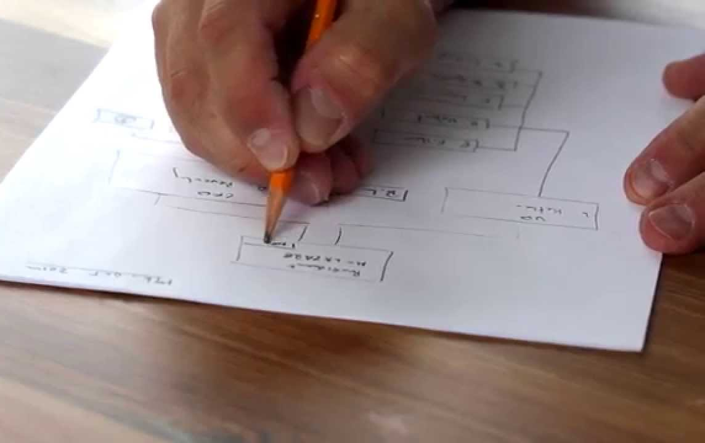
Step:1
ERR-Diagram
We drew the ERR diagram on a paper, noting down all the tables required

Slide 6

ERR diagram

Slide 7
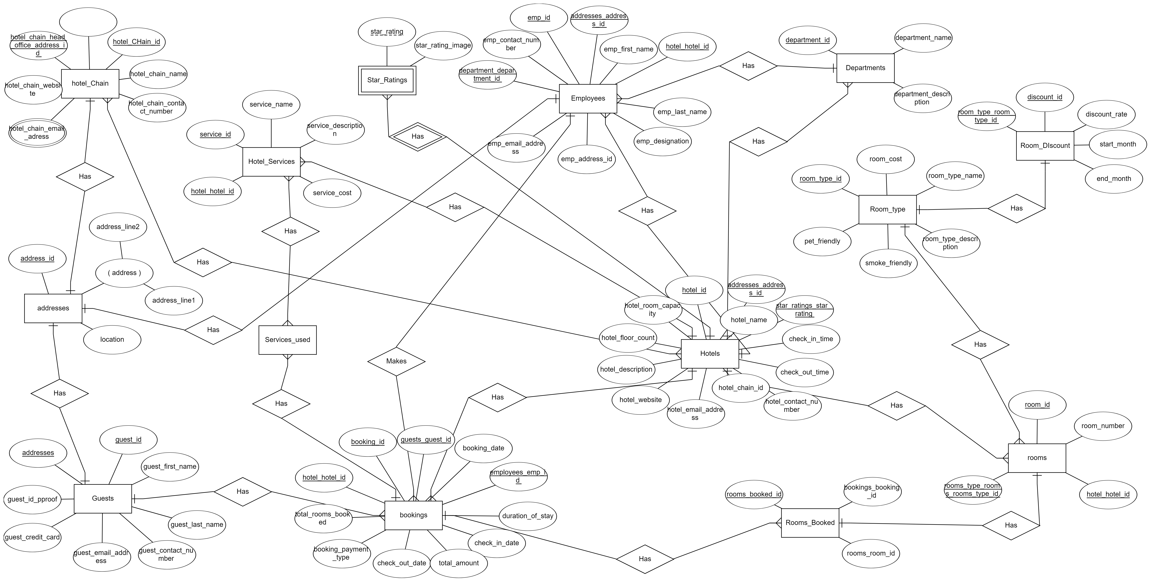

Slide 8
Relational Schema

Slide 9
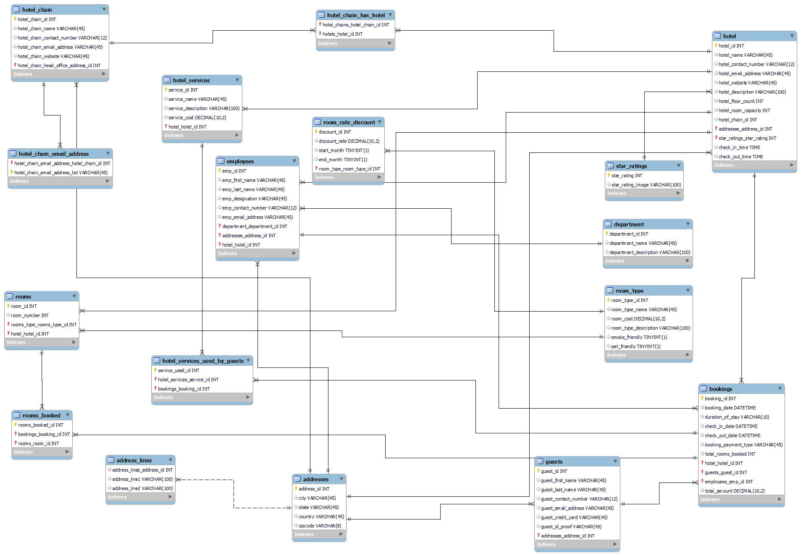

Slide 10
Normalization Process We achieved the first normal form by keeping the data scalar. Coming to the second normal form, we tried to make the relationships depend on the primary key. On the third normal for, we made sure that all the dependencies are only on the primary key of the tables.
Third Normal Form
Second Normal Form
First Normal Form

Slide 11
QUERIES
To execute the required tasks and fetch the data from one or more tables.
Queries Views & Triggers
VIEWS
To view the details of employees along with their departments and also the details of the guests.
TRIGGERS
To create a Booking Audit table and store information about insert and delete bookings records.

Slide 12
Challenges Faced
We faced most of the challenges in creating relationships among tables.
We need to make sure that all the relationships created among tables are logical and follow the normalization rules.
The most challenging part was creating the booking and the rooms table and its relationships with other respective tables.

Slide 13

Thank you very much!

